Slide 1
In this segment
Networks
Introduction to UDP

Slide 2
PROCESS-TO-PROCESS DELIVERY
The transport layer is responsible for process-to-process delivery— the delivery of a packet, part of a message, from one process to another
Two processes communicate in a client/server relationship,

Slide 3
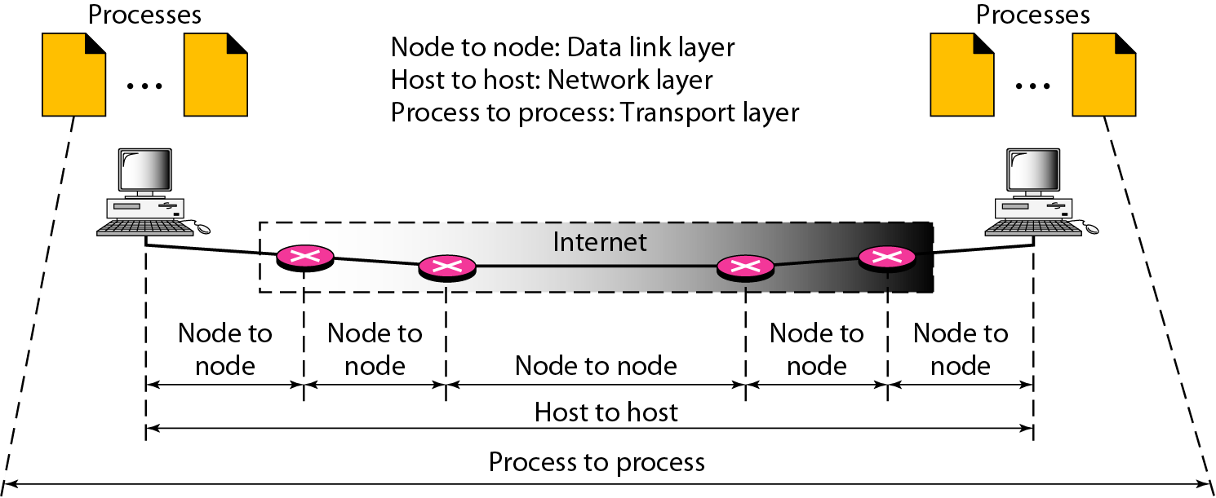
Types of data deliveries

Slide 4
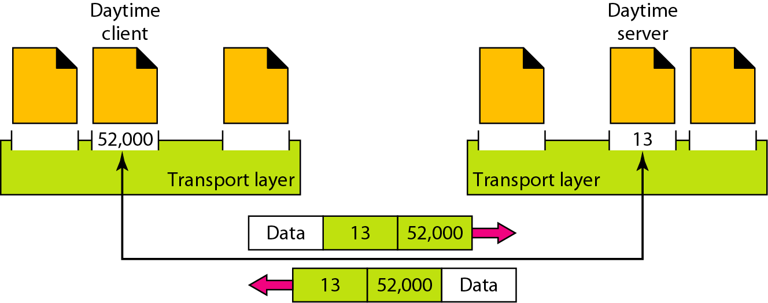
Port numbers

Slide 5
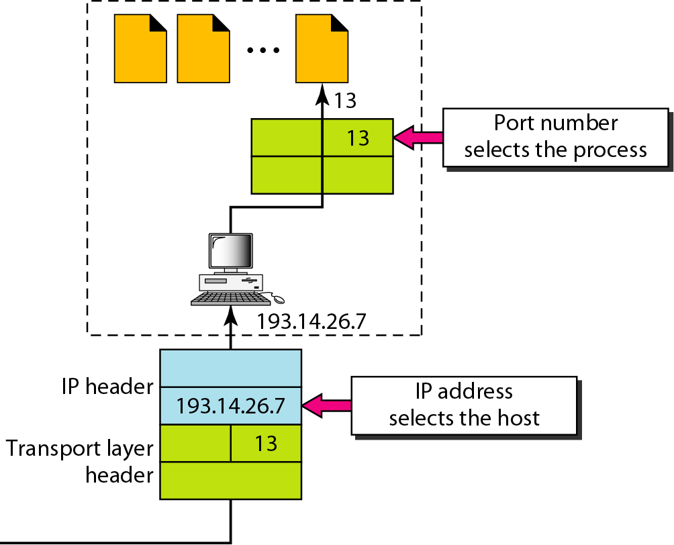
IP addresses versus port numbers

Slide 6
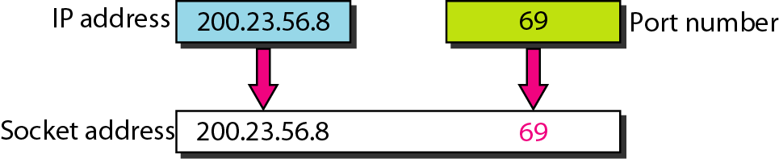
Socket address

Slide 7
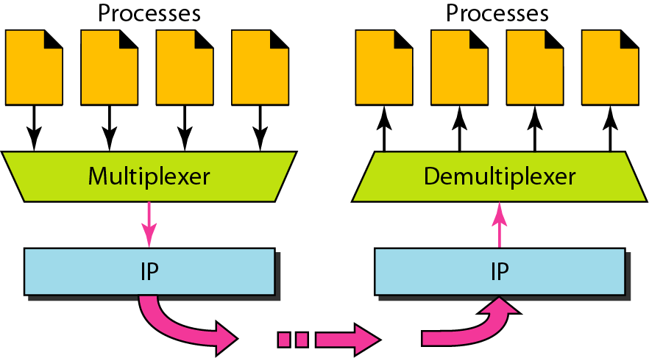
Multiplexing and demultiplexing

Slide 8
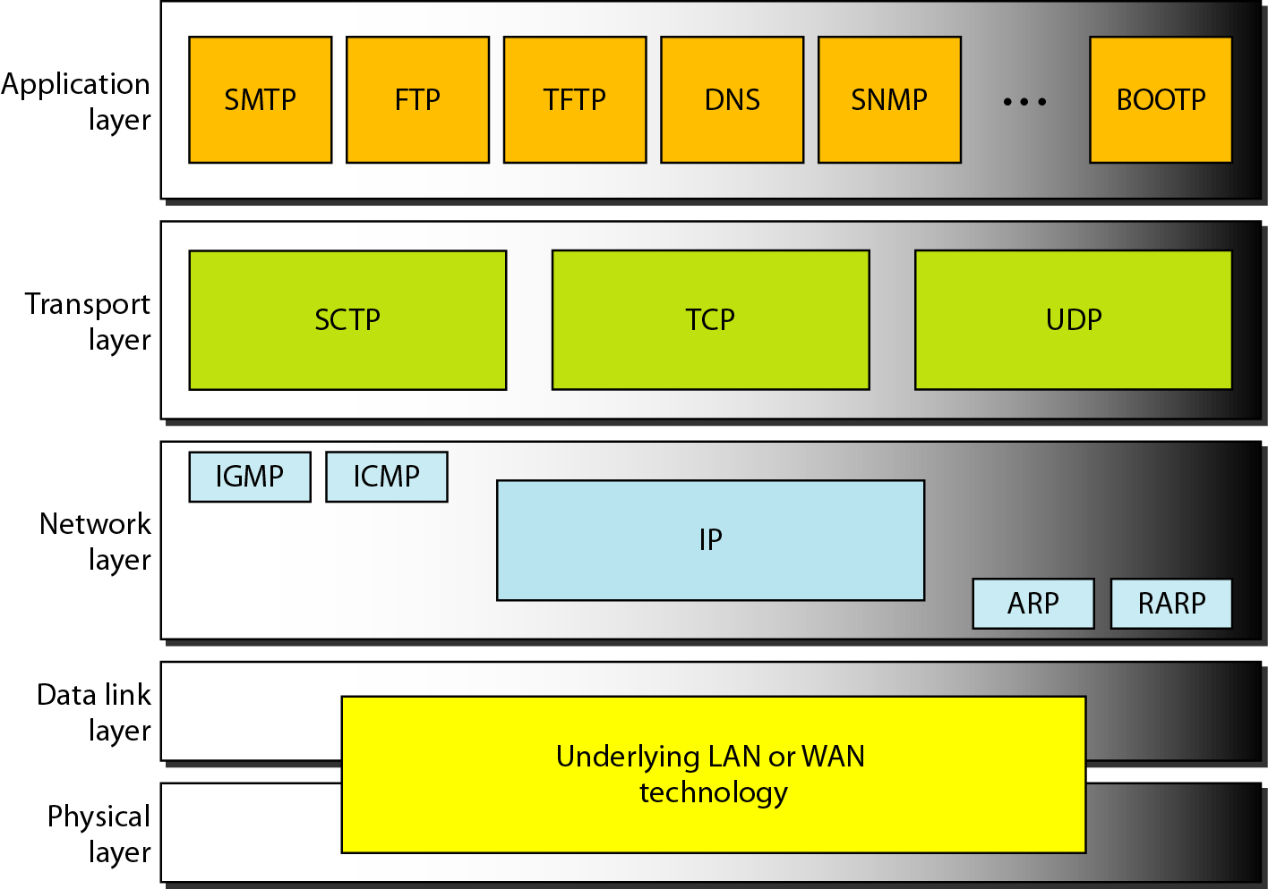
Position of UDP, TCP, and SCTP in TCP/IP suite

Slide 9
USER DATAGRAM PROTOCOL (UDP)
The User Datagram Protocol (UDP) is called a connectionless, unreliable transport protocol
It does not add anything to the services of IP except to provide process-to-process communication instead of host-to-host communication

Slide 10
Well-known ports used with UDP

Slide 11
In UNIX, the well-known ports are stored in a file called /etc/services.
Each line in this file gives the name of the server and the well-known port number.
We can use the grep utility to extract the line corresponding to the desired application.
The following shows the port for FTP.
Note that FTP can use port 21 with either UDP or TCP.

Slide 12
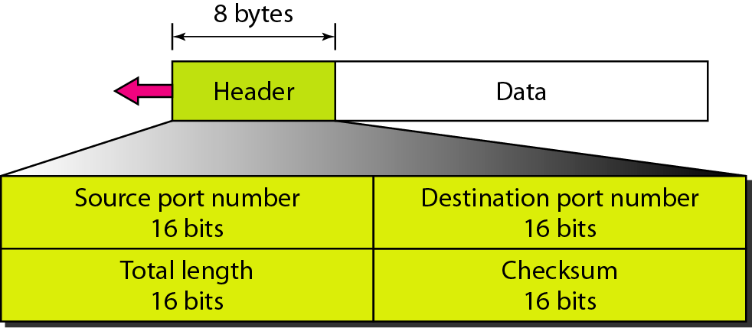
User datagram format

Slide 13
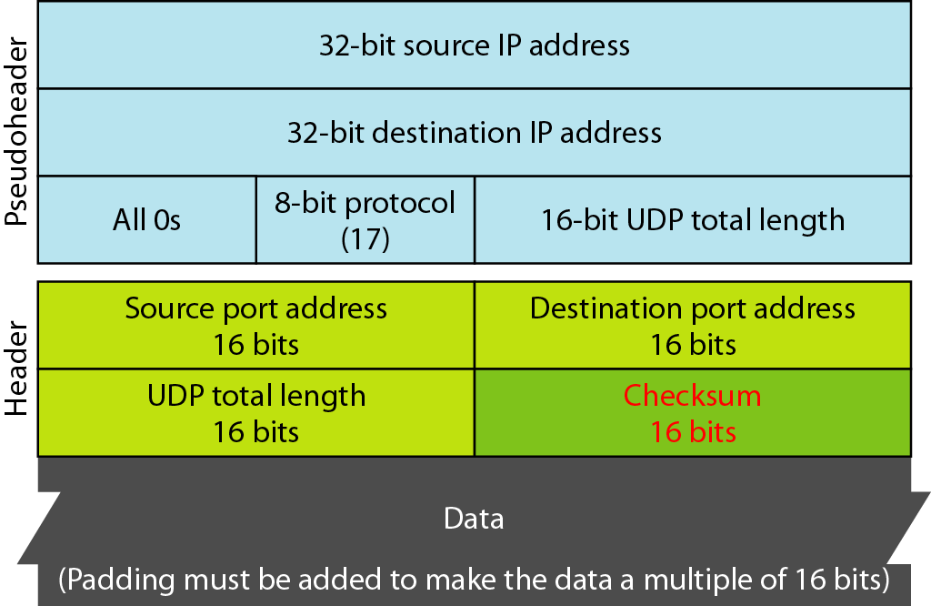
Pseudoheader for checksum calculation

Slide 14
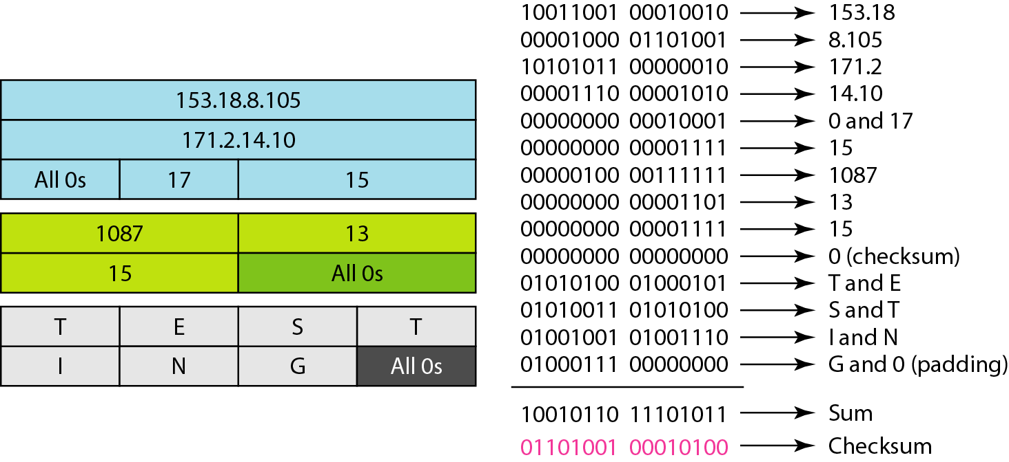
Checksum calculation of a simple UDP user datagram

Slide 15
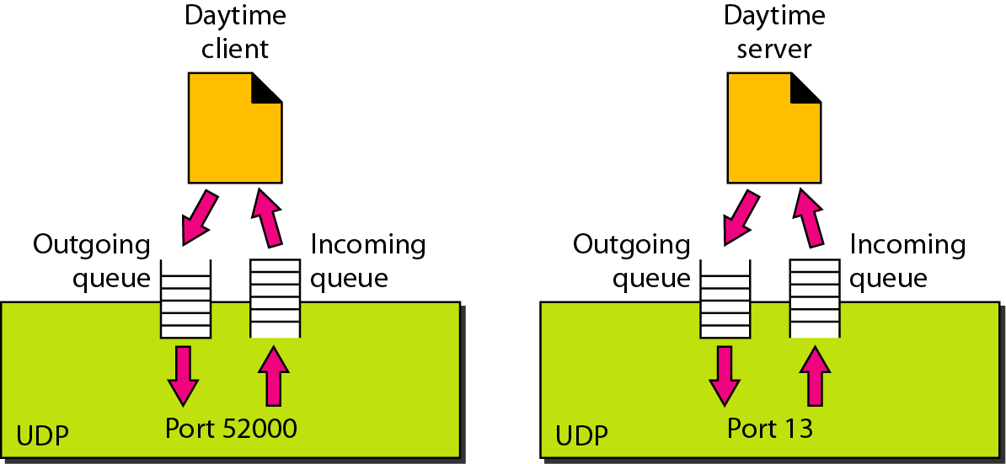
Queues in UDP

Slide 16
In this segment
Connection oriented protocols
Transport Control Protocol

Slide 17
TCP
TCP is a connection-oriented protocol
It creates a virtual connection between two TCPs to send data
In addition, TCP uses flow and error control mechanisms at the transport level

Slide 18
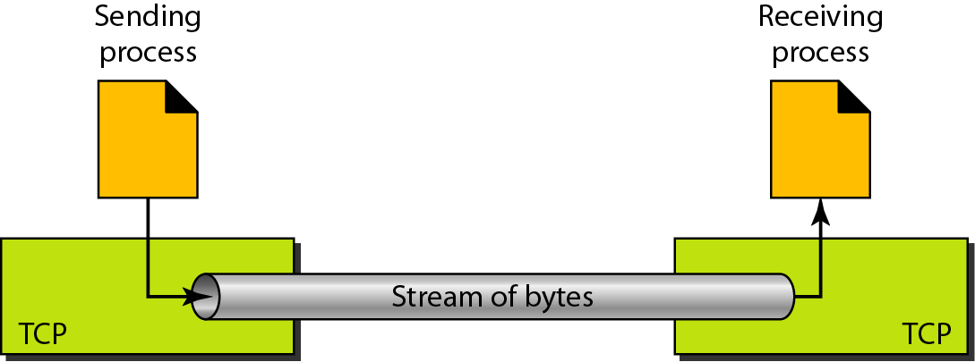
Stream delivery

Slide 19
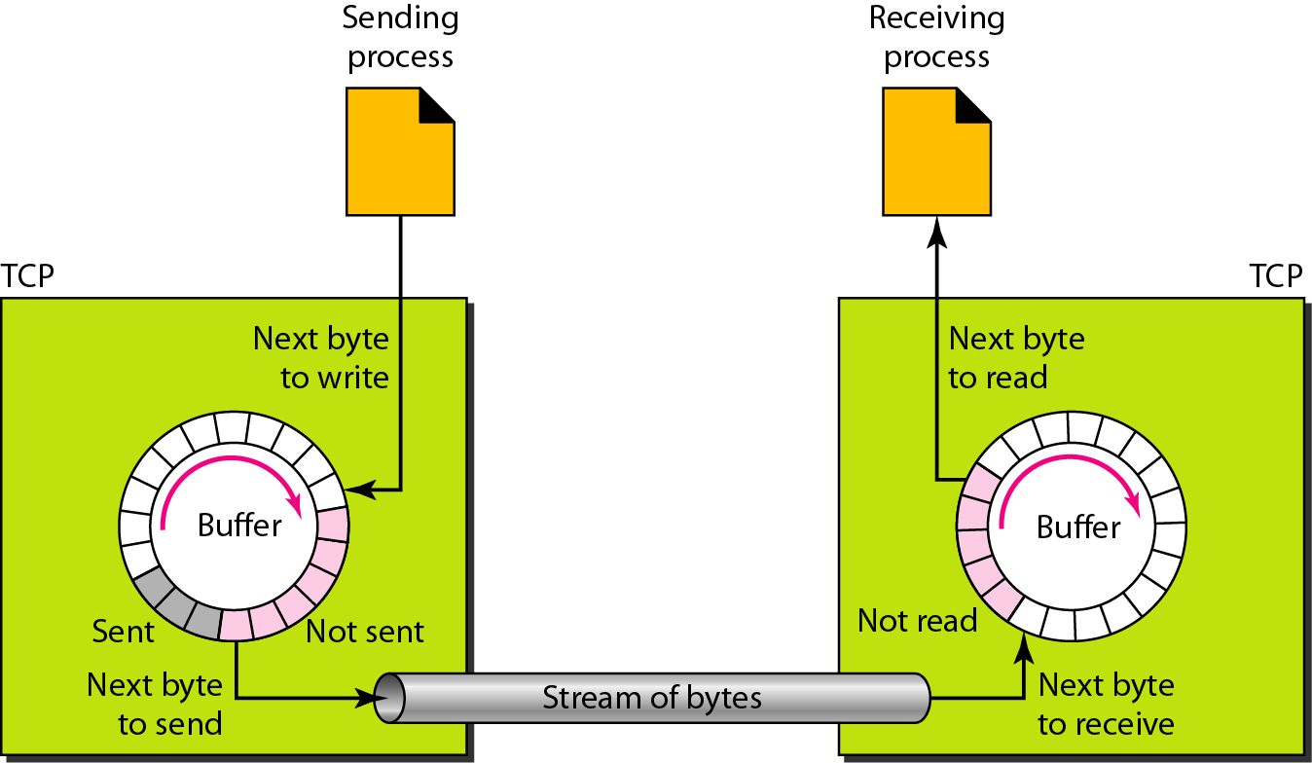
Sending and receiving buffers

Slide 20
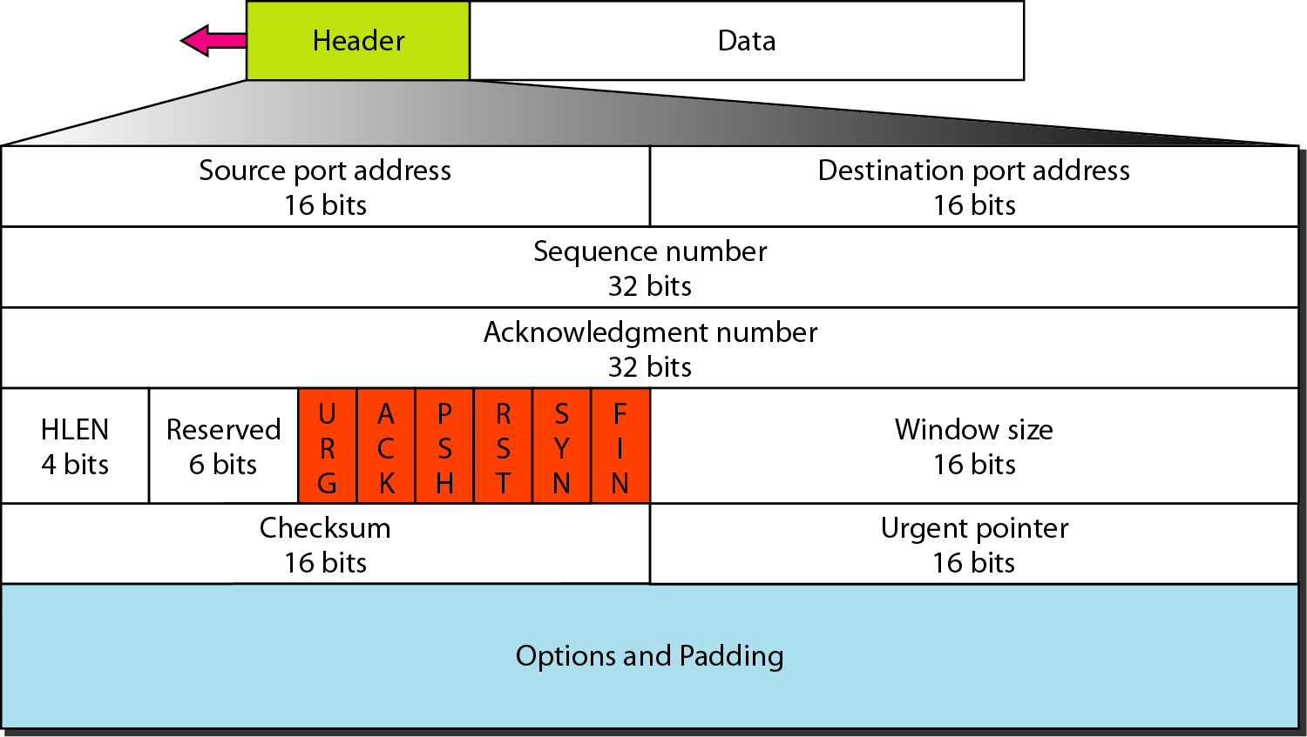
TCP segment format

Slide 21
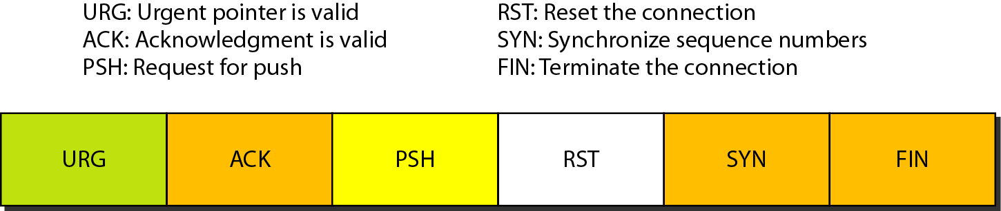
Control field

Slide 22
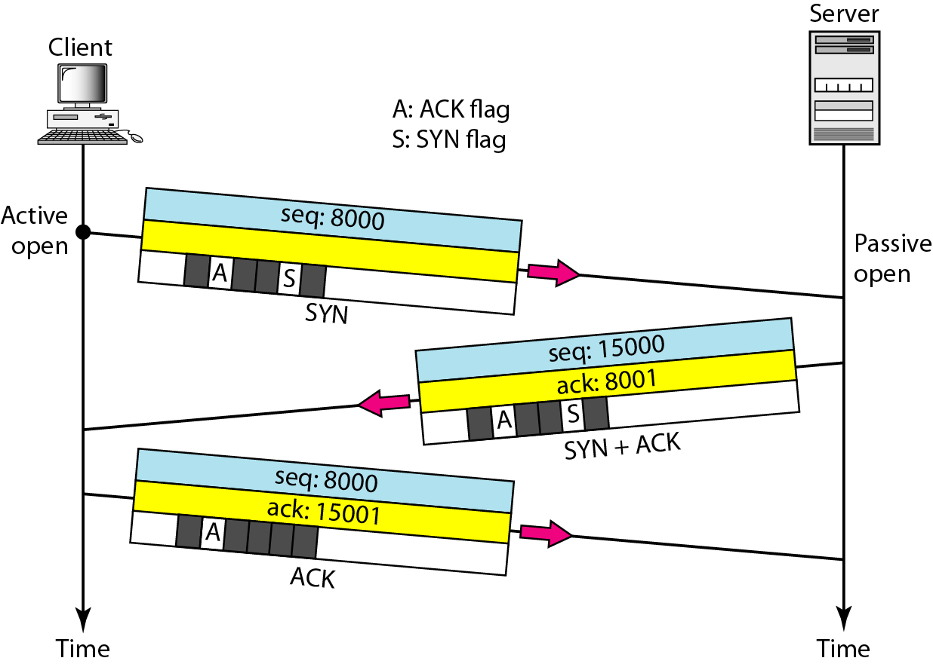
Connection establishment using three-way handshaking

Slide 23
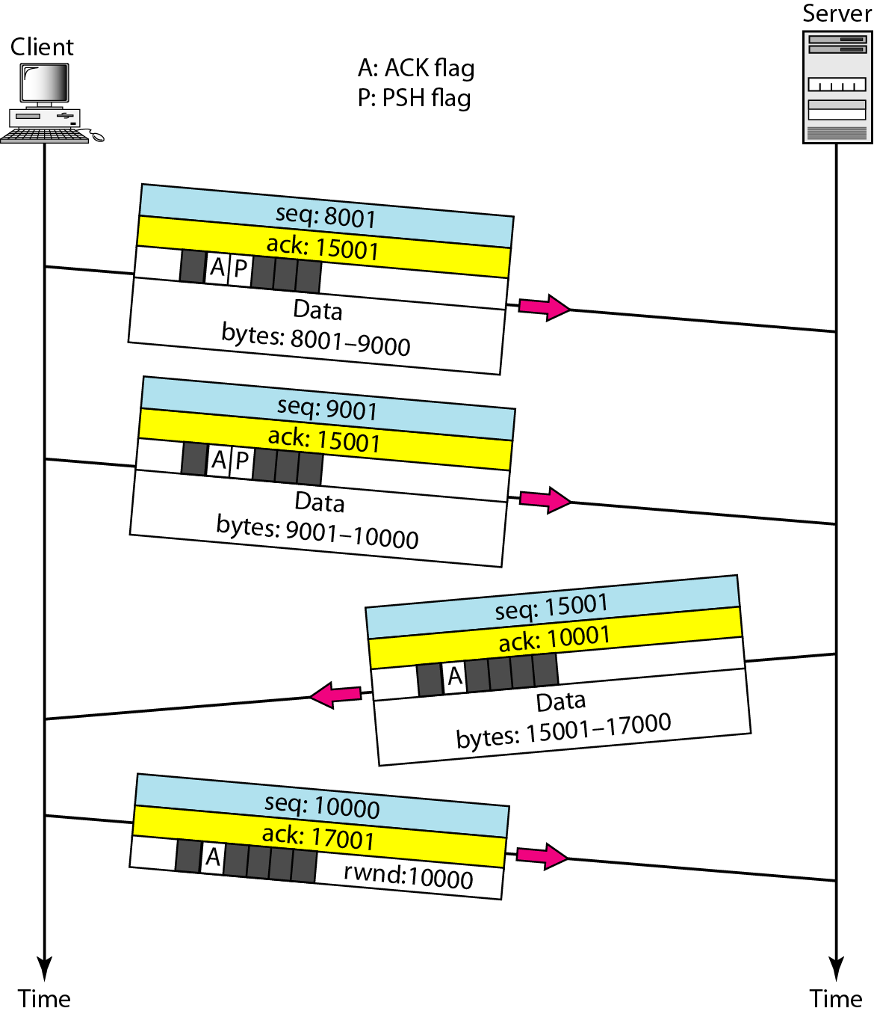
Data transfer

Slide 24
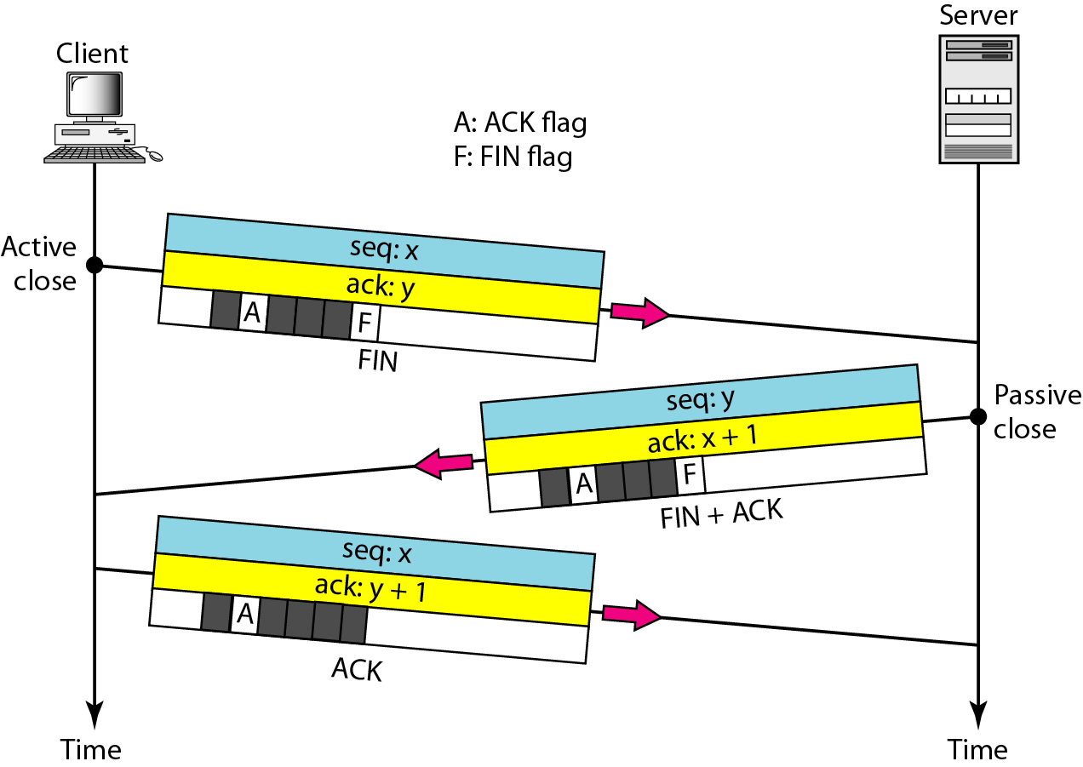
Connection termination using three-way handshaking

Slide 25
In this segment
Client-Sever
Network applications
TCP/IP sockets
Server

Slide 26
A Client-Server Exchange
A server process one or more client processes
Server manages some resource.
Server provides service by manipulating resource for clients.
1. Client sends request
Client
process
Server
process
Resource
4. Client
handles
response
2. Server
handles
request
3. Server sends response
Note: clients and servers are processes running on hosts
(can be the same or different hosts).

Slide 27
Internet Connections (TCP/IP)
Two common paradigms for clients and servers communication
Datagrams (UDP protocol SOCK_DGRAM)
Connections (TCP protocol, SOCK_STREAM)
Connections are point-to-point, full-duplex (2-way communication), and reliable.
Client socket address
128.2.194.242:3479
Server socket address
208.216.181.15:80
Client
Server
(port 80)
Connection socket pair
(128.2.194.242:3479, 208.216.181.15:80)
Client host address
128.2.194.242
Server host address
208.216.181.15
Note: 3479 is an
ephemeral port allocated
by the kernel
Note: 80 is a well-known port
associated with Web servers

Slide 28
Examples of client programs
  Web browsers, ftp, telnet, ssh
How does a client find the server?
  The IP address in the server socket address identifies the host
  The (well-known) port in the server socket address identifies the service, and thus implicitly identifies the server process that performs that service.
  Examples of well known ports
    Port 7: Echo server Port 23: Telnet server
    Port 25: Mail server Port 80: Web server
Clients

Slide 29
Using Ports to Identify Services
Server host 128.2.194.242
Client host
Service request for
128.2.194.242:80
(i.e., the Web server)
Web server
(port 80)
Client
Kernel
Echo server
(port 7)
Service request for
128.2.194.242:7
(i.e., the echo server)
Web server
(port 80)
Client
Kernel
Echo server
(port 7)

Slide 30
Servers
Servers are long-running processes (daemons).
  Created at boot-time (typically) by the init process (process 1)
  Run continuously until the machine is turned off.
Each server waits for requests to arrive on a well-known port associated with a particular service.
  Port 7: echo server
  Port 23: telnet server
  Port 25: mail server
  Port 80: HTTP server
A machine that runs a server process is also often referred to as a “server.”
See /etc/services for a comprehensive list of the services available on a Linux machine.

Slide 31
In this segment
Sockets
Socket addresses
Socket Address Structure

Slide 32
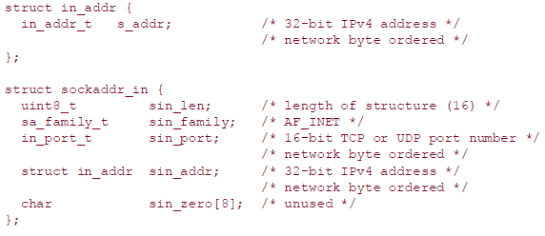
Socket Address Structures
An IPv4 socket address structure, commonly called an "Internet socket address structure,"
It is named sockaddr_in and is defined by including the <netinet/in.h> header

Slide 33
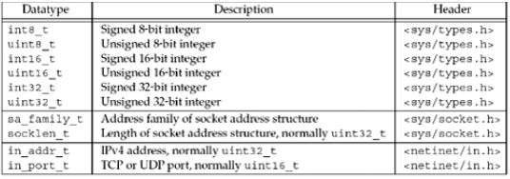
Datatypes required by the POSIX specification

Slide 34

Generic Socket Address Structure
How to declare the type of pointer that may accept any type of pointer?
With ANSI C, the solution is simple: void * is the generic pointer type
The socket functions when take an argument it is defining a variable of generic socket address structure define in the <sys/socket.h>

Slide 35
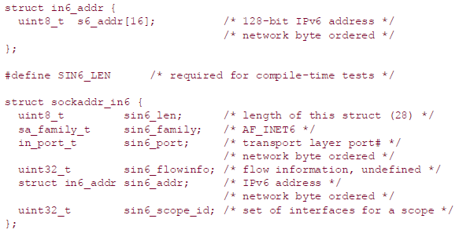
IPv6 Socket Address Structure
The IPv6 socket address is defined by including the <netinet/in.h> header

Slide 36
New Generic Socket Address Structure
A new generic socket address structure was defined as part of the IPv6 sockets API
This is to overcome some of the shortcomings of the existing struct sockaddr
The new struct sockaddr_storage is large enough to hold any socket address type supported by the system

Slide 37
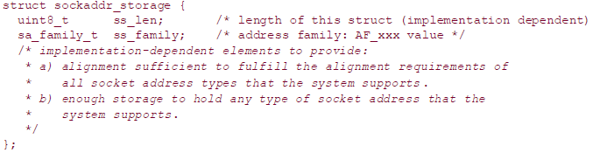
New Generic Socket Address Structure

Slide 38
Value-Result Arguments
when a socket address structure is passed to any socket function, it is always passed by reference
  That is, a pointer to the structure is passed
The length of the structure is also passed as an argument
  But the way in which the length is passed depends on which direction the structure is being passed:
    from the process to the kernel
      bind, connect, and sendto, pass a socket address structure from the process to the kernel
    or vice versa
      accept, recvfrom, getsockname, and getpeername, pass a socket address structure from the kernel to the process

Slide 39

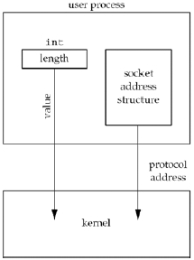
Socket address structure passed
from process to kernel
#define SA struct sockaddr

Slide 40
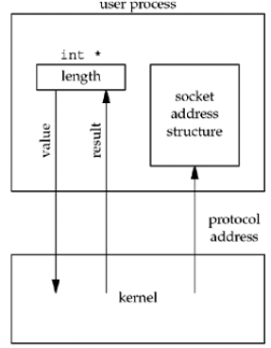
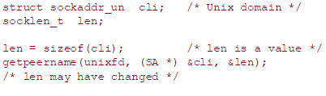
Socket address structure passed from kernel to
process

Slide 41
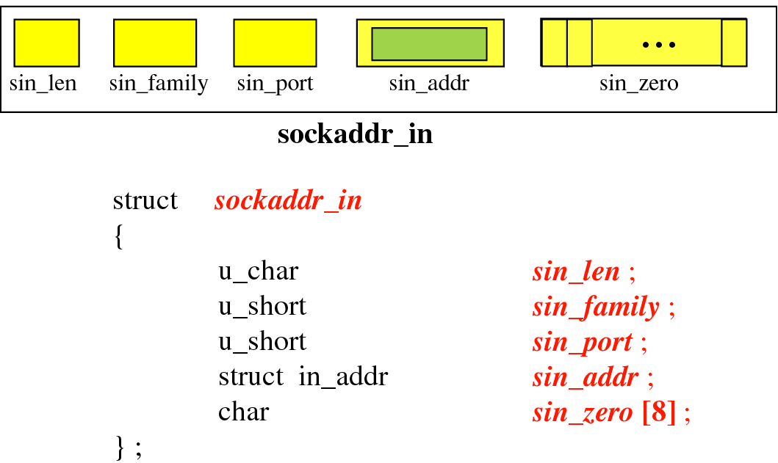
Socket address structure

Slide 42
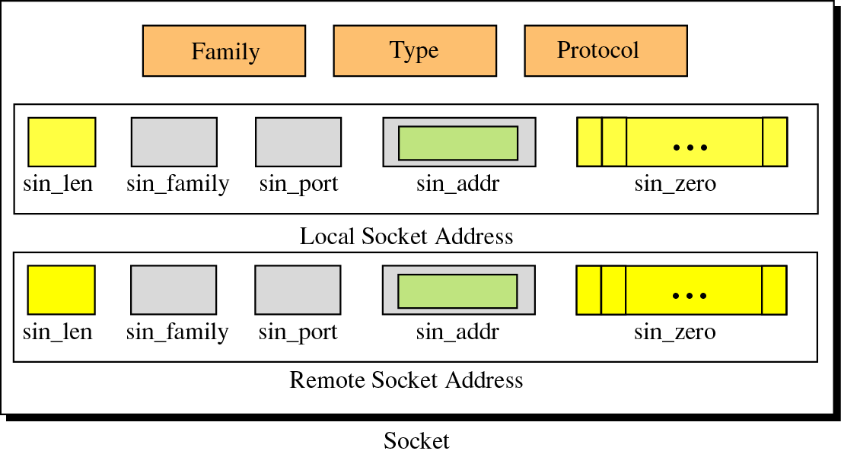
Socket Structure

Slide 43
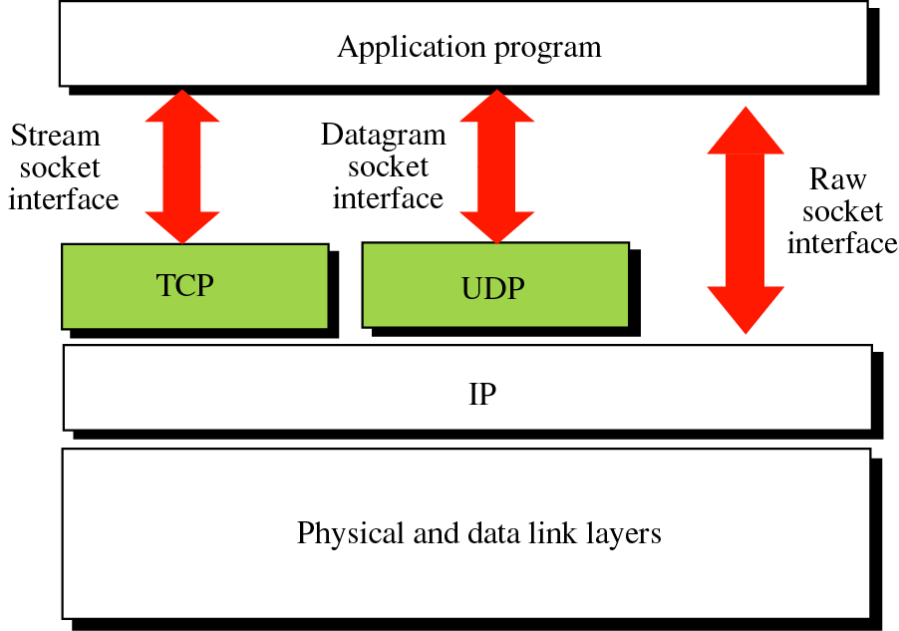
Socket Types

Slide 44
In this segment
Byte ordering
Byte manipulation
inet_aton, inet_addr, and inet_ntoa Functions

Slide 45
Byte Ordering Functions
Consider a 16-bit integer that is made up of 2 bytes
There are two ways to store the two bytes in memory:
  with the low-order byte at the starting address, known as little-endian byteorder
  with the high-order byte at the starting address, known as big-endian byte order

Slide 46
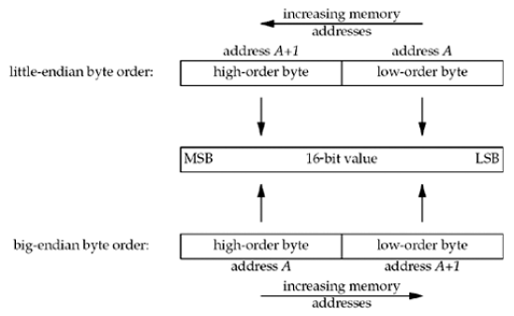
Byte Ordering Functions

Slide 47
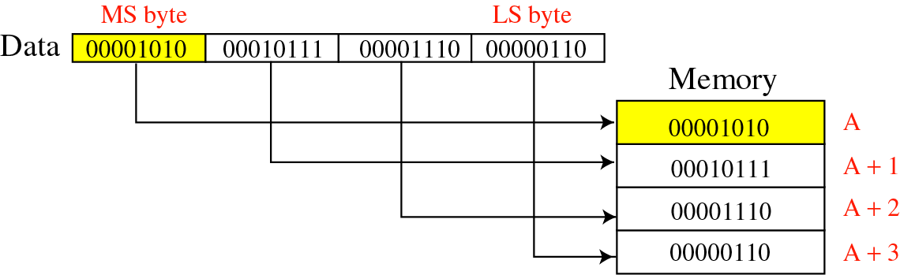
Byte ordering
Big Endian byte-order

Slide 48
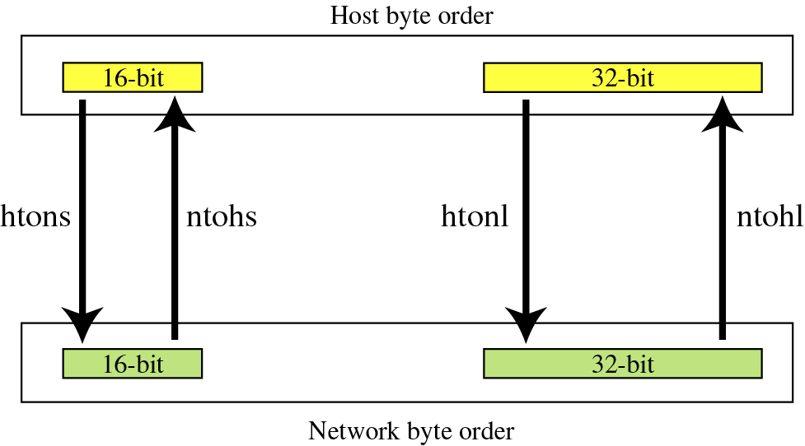
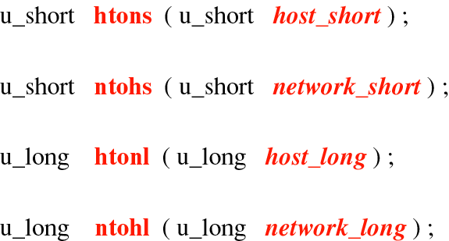
Byte-Order Transformation

Slide 49
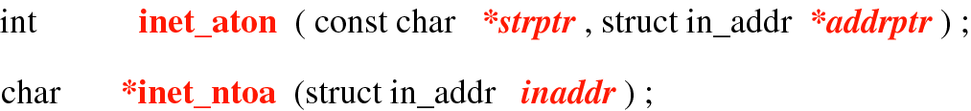
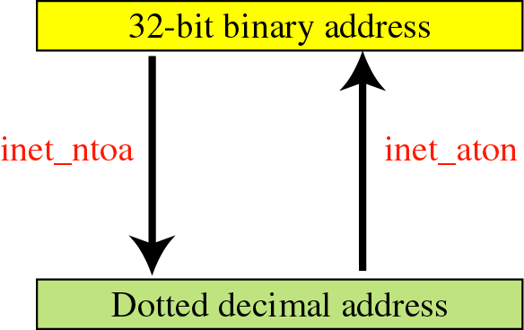
Address Transformation

Slide 50
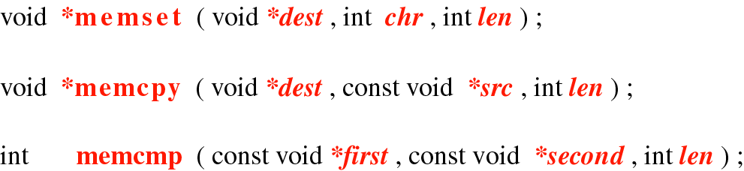
Byte-Manipulation Functions
In network programming, we often need to initialize a field, copy the contents of one field to another, or compare the contents of two fields.
  Cannot use string functions (strcpy, strcmp, …) which assume null character termination.

Slide 51
Byte Manipulation Functions
There are two groups of functions that operate on multibyte fields, without interpreting the data, and without assuming that the data is a null-terminated C string
We need these types of functions when dealing with socket address structures because we need to manipulate fields such as IP addresses
The first group of functions, whose names begin with b (for byte), are from 4.2BSD and are still provided by almost any system that supports the socket functions
The second group of functions, whose names begin with mem (for memory), are from the ANSI C standard and are provided with any system that supports an ANSI C library

Slide 52
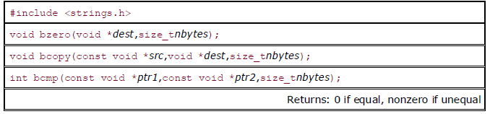
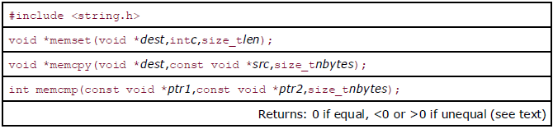
Byte Manipulation Functions

Slide 53
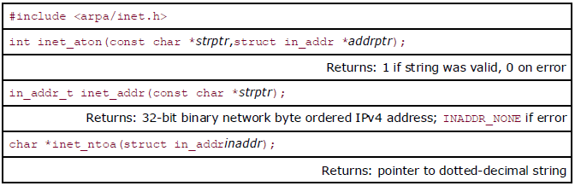
inet_aton, inet_addr, and inet_ntoa Functions
inet_aton, inet_ntoa, and inet_addr convert an IPv4 address from a dotted-decimal string (e.g., "206.168.112.96") to its 32-bit network byte ordered binary value

Slide 54
inet_aton, inet_addr, and inet_ntoa Functions
int inet_aton(const char *strptr, struct in_addr *addrptr);
inet_aton, converts the C character string pointed to by strptr into its 32- bit binary network byte ordered value, which is stored through the pointer addrptr
If successful, 1 is returned; otherwise, 0 is returned
in_addr_t inet_addr(const char *strptr);
inet_addr does the same conversion, returning the 32-bit binary network byte ordered value as the return value
char *inet_ntoa(struct in_addr inaddr);
The inet_ntoa function converts a 32-bit binary network byte ordered IPv4 address into its corresponding dotted-decimal string

Slide 55
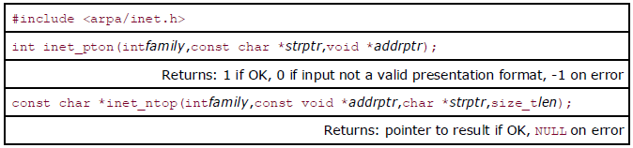
inet_pton and inet_ntop Functions
These two functions work with both IPv4 and IPv6 addresses
The letters "p" and "n" stand for presentation (ASCII string) and numeric (binary value)
The family argument for both functions is either AF_INET or AF_INET6

Slide 56
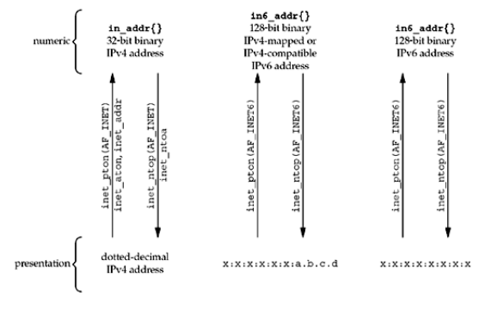
Summary of address conversion functions

Slide 57
In this segment
DNS Servers
Iterated queries
Caching and updating records

Slide 58
DNS: Domain Name System
People use many identifiers:
  ID No, PAN no. name, passport no.
Internet hosts, routers:
  IP address (32 bit) - used for addressing datagrams
  “name”, e.g., www.yahoo.com - used by humans
Q: map between IP addresses and name ?

Slide 59
DNS
Two functions which we use to convert a domain name to IP address:
  gethostbyname() - obsolete
  getaddrinfo() - supports both IPv6 and IPv4
Before DNS, mappings between hostnames and IP addresses were defined in a manually maintained local file, /etc/hosts

Slide 60
DNS
The /etc/hosts scheme scales poorly.
DNS was devised to address this problem.
  Hostnames are organized into a hierarchical namespace.
    Node in the DNS hierarchy has a label (name), which may be up to 63 characters.
    At the root of the hierarchy is an unnamed node, the “anonymous root.”
  A node’s domain name consists of all of the names from that node up to the root concatenated together, with each name separated by a period ( . )

Slide 61
DNS
  No single organization or system manages the entire hierarchy.
    Instead, there is a hierarchy of DNS servers, each of which manages a branch (a zone) of the tree.
    For adding a host, admin has to add it to local name server.
  DNS servers employ caching techniques to avoid unnecessary communication for frequently queried domain names.

Slide 62
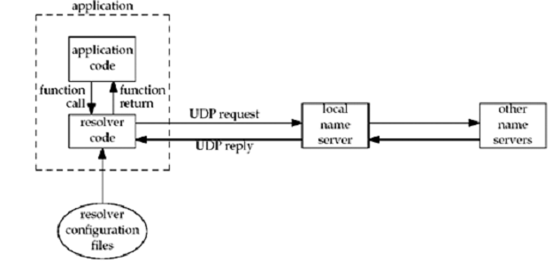
Resolvers and Name Servers

Slide 63
DNS - Domain Name System
Why not centralize DNS?
single point of failure
traffic volume
distant centralized database
Maintenance
doesn’t scale!

Slide 64
Distributed, Hierarchical Database
Client wants IP for www.amazon.com
Client queries a root server to find com DNS server
Client queries com DNS server to get amazon.com DNS server
Client queries amazon.com DNS server to get IP address for www.amazon.com
Root DNS Servers
com DNS servers
org DNS servers
edu DNS servers
yahoo.com
DNS servers
pbs.org
DNS servers
mit.edu
DNS servers
cmu.edu
DNS servers
amazon.com
DNS servers

Slide 65
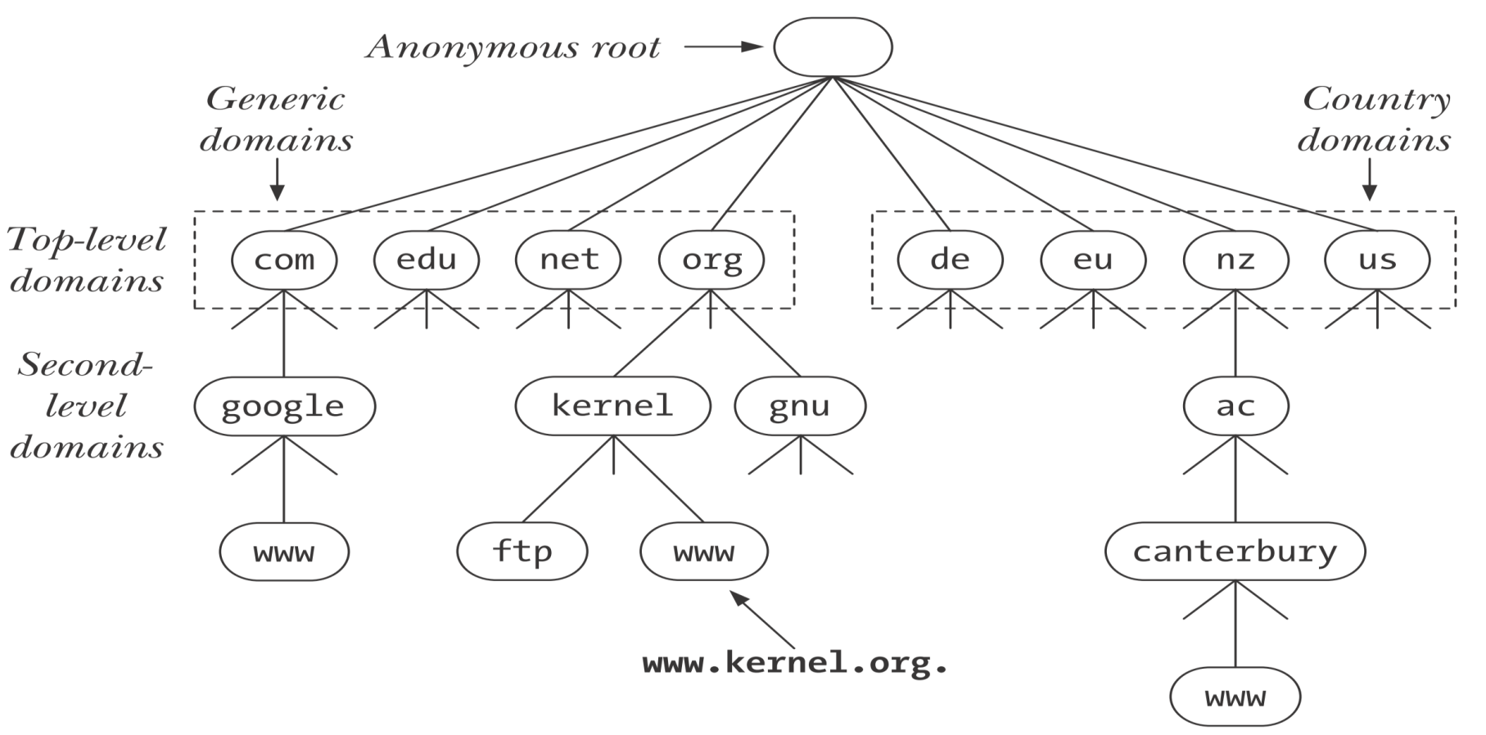
Distributed, Hierarchical Database

Slide 66

DNS: Root name servers
contacted by local name server that can not resolve name
root name server
  contacts authoritative name server if name mapping not known
  gets mapping
  returns mapping to local name server
a Verisign, Dulles, VA
c Cogent, Herndon, VA (also Los Angeles)
d U Maryland College Park, MD
g US DoD Vienna, VA
h ARL Aberdeen, MD
j Verisign, ( 11 locations)
k RIPE London (also Amsterdam, Frankfurt)
i Autonomica, Stockholm (plus 3 other locations)
m WIDE Tokyo
e NASA Mt View, CA
f Internet Software C. Palo Alto, CA (and 17 other locations)
13 root name servers worldwide
b USC-ISI Marina del Rey, CA
l ICANN Los Angeles, CA

Slide 67
TLD and Authoritative Servers
Top-level domain (TLD) servers: responsible for com, org, net, edu, gov , int and all top-level country domains uk, fr, ca, jp.
  Network solutions maintains servers for com TLD
  Educational use for edu TLD
Authoritative DNS servers: organization’s DNS servers, providing authoritative hostname to IP mappings for organization’s servers (e.g., Web and mail).
  Can be maintained by organization or service provider

Slide 68
Local Name Server
Does not strictly belong to hierarchy
Each ISP (residential ISP, company, university) has one
  Also called “default name server”
When a host makes a DNS query, query is sent to its local DNS server
  Acts as a proxy, forwards query into hierarchy

Slide 69
DNS Lookup
Not every name server knows about every other name server.
Name server must know the IP address of root servers.
Root servers know the name and location for all second-level domains.

Slide 70
Recursive and Iterative Lookups
DNS resolution requests fall into two categories: recursive and iterative.
  In a recursive request, the requester asks the server to handle the entire task of resolution.
When an application on the local host calls getaddrinfo(), that function makes a recursive request to the local DNS server.
If the local DNS server does not itself have the information to perform the resolution, it resolves the domain name iteratively.

Slide 71
Example
Host at cis.poly.edu wants IP address for gaia.cs.umass.edu
root DNS server
2
3
4
5
dns.umass.edu
local DNS server
dns.poly.edu
7
6
1
8
authoritative DNS server
dns.cs.umass.edu
requesting host
cis.poly.edu
gaia.cs.umass.edu

Slide 72
Recursive queries
recursive query:
puts burden of name resolution on contacted name server
heavy load?
iterated query:
contacted server replies with name of server to contact
“I don’t know this name, but ask this server”
root DNS server
2
3
7
6
dns.umass.edu
local DNS server
dns.poly.edu
5
4
1
8
authoritative DNS server
dns.cs.umass.edu
requesting host
cis.poly.edu
gaia.cs.umass.edu

Slide 73
The /etc/services File
Well-known port numbers are centrally registered by IANA.
  Each of these ports has a corresponding service name.
    Because service numbers are centrally managed and are less volatile than IP addresses, an equivalent of the DNS server is usually not necessary. Instead, the port numbers and service names are recorded in the file /etc/services .
  The getaddrinfo() and getnameinfo() functions use the information in this file to convert service names to port numbers and vice versa.

Slide 74
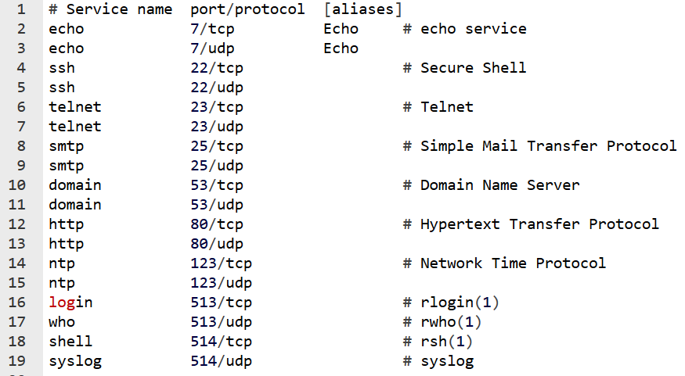
The /etc/services File

Slide 75
In this segment
Elementary sockets
Socket function
Bind function
Connect function
Listen function

Slide 76
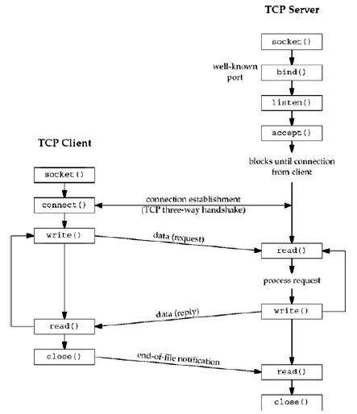
Socket functions
for elementary
TCP client/server

Slide 77
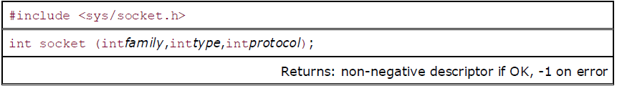
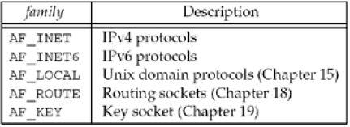
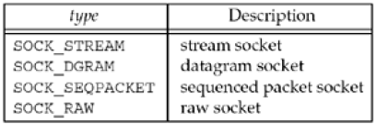
Socket Function
family specifies the protocol family and is one of the constants shown in Figure

Slide 78
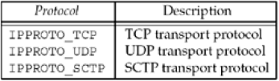
Socket Function
The socket type is one of the constants shown in Figure
The protocol argument to the socket function should be set to the specific protocol type found in Figure, or 0 to select the system's default for the given combination of family and type

Slide 79
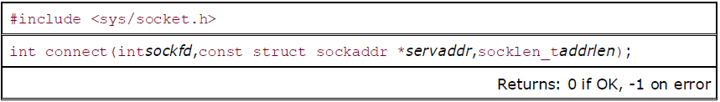
Connect Function
The connect function is used by a TCP client to establish a connection with a TCP server
sockfd is a socket descriptor returned by the socket function
The second and third arguments are a pointer to a socket address structure and its size
The socket address structure must contain the IP address and port number of the server

Slide 80
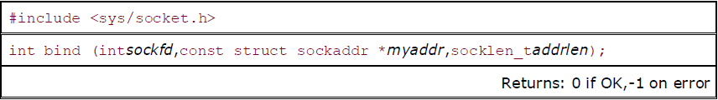
Bind Function
The bind function assigns a local protocol address to a socket (sockfd)
With the Internet protocols, the protocol address is the combination of either a 32-bit IPv4 address or a 128-bit IPv6 address, along with a 16-bit TCP or UDP port number
The second argument is a pointer to a protocol-specific address
The third argument is the size of this address structure

Slide 81
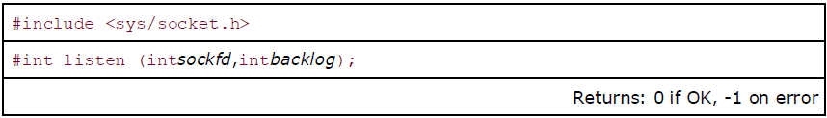
Listen Function
The listen function is called only by a TCP server and it performs two actions:
When a socket is created by the socket function, it is assumed to be an active socket, that is, a client socket that will issue a connect
The listen function converts an unconnected socket into a passive socket, indicating that the kernel should accept incoming connection requests directed to this socket
The second argument to this function specifies the maximum number of connections the kernel should queue for this socket

Slide 82


The two queues maintained by TCP for a listening socket

Slide 83

Accept Function
accept is called by a TCP server to return the next completed connection from the front of the completed connection queue
If the completed connection queue is empty, the process is put to sleep (assuming the default of a blocking socket)
The cliaddr and addrlen arguments are used to return the protocol address of the connected peer process (the client)
addrlen is referred by the integer value to the size of the socket address structure pointed to by cliaddr
If accept is successful, its return value is a brand-new descriptor automatically created by the kernel that refers to the TCP connection with the client

Slide 84

Close Function
The normal Unix close function is also used to close a socket and terminate a TCP connection

Slide 85
TCP Client
PF_INET
PF_INET6
PF_UNIX
PF_X25
STREAM
DGRAM
RAW
0, used by RAW socket
sd = socket (family, type, protocol);
family
port
ephemeral port
ip addr
(routing)
three way
handshaking
addr
sd = connect (sd, server_addr, addr_len);
write (sd, *buff, mbytes);
Server PORT#
IP-ADDR
CONNECT actions
1. socket is valid
2. fill remote endpoint addr/port
3. choose local endpoint add/port
4. initiate 3-way handshaking
read (sd, *buff, mbytes);
disconnect
sequence
close (sd);

Slide 86
TCP Server
LISTEN
SOCKET
sd = socket (family, type, protocol);
family
port
well-known port #
INADDR_ANY
addr
bind port #
bind (sd, *server_addr, len);
listen (sd, backlog);
1. Turn sd from active to passive
2. Queue length
family
CONNECT
SOCKET
three way
handshaking
ssd = accept (sd, *cliaddr, *len);
port
addr
read (ssd, *buff, mbytes);
closes socket for R/W
non-blocking
attempts to send unsent data
socket option SO_LINGER
block until data sent
write (ssd, *buff, mbytes);
disconnect
sequence
close (ssd);

Slide 87
In this segment
TCP client-server interaction
TCP Web server
TCP Web client

Slide 88
Review: TCP Client-Server Interaction
TCP Server
socket()
bind()
TCP Client
listen()
socket()
accept()
connection establishment
connect()
data request
write()
read()
data reply
write()
read()
end-of-file notification
read()
close()
close()
88

Slide 89
TCP Server
For example: web server
What does a web server need to do so that a web client can connect to it?
Web Server
Port 80
TCP
IP
Ethernet Adapter
89

Slide 90
Socket I/O: socket()
Since web traffic uses TCP, the web server must create a socket of type SOCK_STREAM
socket returns an integer (socket descriptor)
  fd < 0 indicates that an error occurred
AF_INET associates a socket with the Internet protocol family
SOCK_STREAM selects the TCP protocol
int fd; /* socket descriptor */
if((fd = socket(AF_INET, SOCK_STREAM, 0)) < 0) {
perror(“socket”);
exit(1);
}

Slide 91
Socket I/O: connect()
connect allows a client to connect to a Webserver...
int fd; /* socket descriptor */
struct sockaddr_in srv; /* used by connect() */
/* create the socket */
/* connect: use the Internet address family */
srv.sin_family = AF_INET;
/* connect: socket ‘fd’ to port 80 */
srv.sin_port = htons(80);
/* connect: connect to IP Address “128.2.35.50” */
srv.sin_addr.s_addr = inet_addr(“128.2.35.50”);
if(connect(fd, (struct sockaddr*) &srv, sizeof(srv)) < 0) {
perror(”connect"); exit(1);
}

Slide 92
Socket I/O: bind()
A socket can be bound to a port
int fd; /* socket descriptor */
struct sockaddr_in srv; /* used by bind() */
/* create the socket */
srv.sin_family = AF_INET; /* use the Internet addr family */
srv.sin_port = htons(80); /* bind socket ‘fd’ to port 80*/
/* bind: a client may connect to any of my addresses */
srv.sin_addr.s_addr = htonl(INADDR_ANY);
if(bind(fd, (struct sockaddr*) &srv, sizeof(srv)) < 0) {
perror("bind"); exit(1);
}
Still not quite ready to communicate with a client...

Slide 93
Socket I/O: listen()
listen indicates that the server will accept a connection
Still not quite ready to communicate with a client...
int fd; /* socket descriptor */
struct sockaddr_in srv; /* used by bind() */
/* 1) create the socket */
/* 2) bind the socket to a port */
if(listen(fd, 5) < 0) {
perror(“listen”);
exit(1);
}

Slide 94
Socket I/O: accept()
accept blocks waiting for a connection
accept returns a new socket (newfd) with the same properties as the original socket (fd). newfd < 0 indicates that an error occurred
int fd; /* socket descriptor */
struct sockaddr_in srv; /* used by bind() */
struct sockaddr_in cli; /* used by accept() */
int newfd; /* returned by accept() */
int cli_len = sizeof(cli); /* used by accept() */
/* 1) create the socket */
/* 2) bind the socket to a port */
/* 3) listen on the socket */
newfd = accept(fd, (struct sockaddr*) &cli, &cli_len);
if(newfd < 0) {
perror("accept"); exit(1);
}

Slide 95
Socket I/O: accept() continued...
How does the server know which client it is?
  cli.sin_addr.s_addr contains the client’s IP address
  cli.sin_port contains the client’s port number
Now the server can exchange data with the client by using read and write on the descriptor newfd.
Why does accept need to return a new descriptor?
struct sockaddr_in cli; /* used by accept() */
int newfd; /* returned by accept() */
int cli_len = sizeof(cli); /* used by accept() */
newfd = accept(fd, (struct sockaddr*) &cli, &cli_len);
if(newfd < 0) {
perror("accept");
exit(1);}

Slide 96
Socket I/O: read()
read can be used with a socket
read blocks waiting for data from the client but does not guarantee that sizeof(buf) is read
int fd; /* socket descriptor */
char buf[512]; /* used by read() */
int nbytes; /* used by read() */
/* 1) create the socket */
/* 2) bind the socket to a port */
/* 3) listen on the socket */
/* 4) accept the incoming connection */
if((nbytes = read(newfd, buf, sizeof(buf))) < 0) {
perror(“read”); exit(1);
}

Slide 97
TCP Client
For example: web client
How does a web client connect to a web server?
2 Web Clients
TCP
IP
Ethernet Adapter

Slide 98
Dealing with IP Addresses
IP Addresses are commonly written as strings (“128.2.35.50”), but programs deal with IP addresses as integers.
Converting strings to numerical address:
struct sockaddr_in srv;
srv.sin_addr.s_addr = inet_addr(“128.2.35.50”);
if(srv.sin_addr.s_addr == (in_addr_t) -1) {
fprintf(stderr, "inet_addr failed!\n"); exit(1);
}

Slide 99
Dealing with IP Addresses
IP Addresses are commonly written as strings (“128.2.35.50”), but programs deal with IP addresses as integers.
Converting a numerical address to a string:
struct sockaddr_in srv;
char *t = inet_ntoa(srv.sin_addr);
if(t == 0) {
fprintf(stderr, “inet_ntoa failed!\n”); exit(1);
}

Slide 100
Translating Names to Addresses
Gethostbyname provides interface to DNS
Additional useful calls
  Gethostbyaddr – returns hostent given sockaddr_in
  Getservbyname
    Used to get service description (typically port number)
    Returns servent based on name
#include <netdb.h>
struct hostent *hp; /*ptr to host info for remote*/
struct sockaddr_in peeraddr;
char *name = “www.cs.cmu.edu”;
peeraddr.sin_family = AF_INET;
hp = gethostbyname(name)
peeraddr.sin_addr.s_addr = ((struct in_addr*)(hp->h_addr))->s_addr;

Slide 101
Socket I/O: connect()
connect allows a client to connect to a server...
int fd; /* socket descriptor */
struct sockaddr_in srv; /* used by connect() */
/* create the socket */
/* connect: use the Internet address family */
srv.sin_family = AF_INET;
/* connect: socket ‘fd’ to port 80 */
srv.sin_port = htons(80);
/* connect: connect to IP Address “128.2.35.50” */
srv.sin_addr.s_addr = inet_addr(“128.2.35.50”);
if(connect(fd, (struct sockaddr*) &srv, sizeof(srv)) < 0) {
perror(”connect"); exit(1);
}

Slide 102
Socket I/O: write()
write can be used with a socket
int fd; /* socket descriptor */
struct sockaddr_in srv; /* used by connect() */
char buf[512]; /* used by write() */
int nbytes; /* used by write() */
/* 1) create the socket */
/* 2) connect() to the server */
/* Example: A client could “write” a request to a server */
if((nbytes = write(fd, buf, sizeof(buf))) < 0) {
perror(“write”);
exit(1);
}

Slide 103
In this segment
Elementary UDP sockets
recvfrom, sendto functions
echo client-server

Slide 104

Socket functions for UDP client/server

Slide 105

recvfrom and sendto Functions
These two functions are similar to the standard read and write functions, but three additional arguments are required
The first three arguments, sockfd, buff, and nbytes, are identical to the first three arguments for read and write: descriptor, pointer to buffer to read into or write from, and number of bytes to read or write

Slide 106
recvfrom and sendto Functions
For sendto: a socket address structure containing the protocol address (e.g., IP address and port number) of where the data is to be sent
The size of this socket address structure is specified by addrlen
For recvfrom: function fills in the socket address structure pointed to by from with the protocol address of who sent the datagram
The number of bytes stored in this socket address structure is also returned to the caller in the integer pointed to by addrlen
For now, we will always set the flags to 0

Slide 107

UDP Client-Server
We will use echo protocol.
Server
  Create UDP socket & bind at well-known port number.
  Read datagram and echo back to sender
Client
  Create UDP Socket
  Read from stdin and send datagram to server
  Read from UDP socket and write to stdout.

Slide 108

UDP Server
  UDP socket is created by specifying the second argument as SOCK_DGRAM.

Slide 109

UDP Server
  This function never terminates.
  Since UDP is connectionless protocol, there is nothing like an EOF as in TCP.

Slide 110
UDP Server
UDP is an iterative server.
  Client requests are handled one after another. There is no call to fork().
  In general most TCP servers are concurrent, and most UDP servers are iterative.
UDP socket has a receive buffer. Incoming datagrams are queued there.
  When server calls recvfrom(), a datagram is returned in FIFO order.
  Buffer has a limited size (default 40000bytes).

Slide 111


TCP Server vs UDP Server
  In TCP server, there is connected socket for each client and there is separate buffer in each socket.
  In UDP server, datagrams from all clients are placed in a single buffer. No separate socket for each client.

Slide 112

UDP Client
When client uses sendto() at that kernel allocates an ephemeral port to the socket local endpoint.

Slide 113

UDP Client
n recvfrom() last two arguments are specified as NULL. This tells the kernel that we are not interested in knowing who sent the reply.

